Slide 2
Agenda
Introduction to the panel
NSW $10,000 grant
Quick Review of Stimulus Measures
Jobkeeper
Q & A

Slide 3
Welcome from
Daniel Fisher - B. Commerce, M. Finance
Daniel has experience in finance and management, having worked with a variety of small businesses and in Government, notably at the Department of Defense. Daniel's core business strengths are in management, financial analysis and modeling budgeting, business planning and whole business strategy.
Financial Modelling – Business Modelling – Forensic Business Strategy
Mark Oosterveen - B.Business (Ag Commerce)
Mark has been involved in Agricultural business and banking sector for over 25 years. Core strengths are business development, client management, risk management and financial analysis with-in the agricultural, agri-business and accommodation sectors. Outside of work, I am involved in a family farming partnership focused on winter cereal crops, beef and prime lambs.
Agriculture – Agri-Business – Accommodation – Finance & Banking – Business Modelling
John Curley– MBA (Accounting), MTax, Chartered Accountant
John is the director of Peacocke Accountants. He is an ex-farmer turned accountant after a back injury, forced a change of career. He and his team promote king for a wide range of businesses over the years has given him significant understanding of the unique needs of you our client. He’s also a Xero cloud accounting champion.

Slide 4
NSW $10,000 Grant
Eligibility
Have between 1-19 employees and a turnover of more than $75,000;
A payroll below the NSW Government 2019-20 payroll tax threshold of $900,000;
ABN registered as at 1 March 2020,
Based in NSW and employ staff as at 1 March 2020;
Be highly impacted by the Public Health restrictions on Gathering and Movement, as at 30 March 2020;
Use the funding for unavoidable business costs such as utilities, overheads, legal costs and financial advice;
Provide appropriate documentation upon application.
Available from 17th April 2020 - Service NSW website
https://www.service.nsw.gov.au/campaign/covid-19-help-small-businesses/grants-loans-and-financial-assistance
Impacted Industries
Businesses that have been subject to closure or are highly impacted by NSW Government health directions
Retail trade
Accommodation and food service
Rental, hiring and real estate services
Administrative and support services
Arts and recreation services.

Slide 5
Electricity & Gas Network Relief
Small Business - Full Tariff Relief
Network charges will be rebated for small business customers experiencing financial stress and who are mothballing as a result of COVID-19
Relief will apply to all small business customers who:
Are mothballing over the period of 1 April to 30 June 2020 as a result of COVID-19
Eligible small business customers are those that consume less than 40MWh or 400GJ per annum (based on 2019 consumption) and use less than 25% of historical average consumption for the period
This will apply for customer network charges from 1 April to 30 June 2020
Rebating of payments will be processed by networks in arrears of monthly invoicing, with networks providing a rebate of the relevant network charges by the end of September 2020 for the period from 1 April to 30 June 2020 following receipt of supporting evidence by 1 September 2020
https://www.energynetworks.com.au/miscellaneous/covid-19-electricity-and-gas-network-relief-package/

Slide 6
Support for Business
Instant Write off
Increase the cost threshold from $30,000 to $150,000 from 12th March 2020 to 30th June 2020 (will revert to $1,000 as of the 1st July 2020 – at this stage)
“Instant Asset Write Off” has been expanded to businesses with an aggregated turnover of up to $500 million.
Additional 5,000 businesses can access this that employ 1.9 million people. (existing cap - $50 million).

Slide 7
Support for Business
Warning re Motor Vehicles
If it is a passenger vehicle then Depreciation limited to the Car limit of $57,581.
Quick example, Sally purchases a new BMW for $150,000 and uses it 50% in her business.
GST limited to 50% of $5,758.10 (10% GST on $57,581)
Instant write off limited to 50% of $57,581 = $28,791

Slide 8
Objective of Economic Response
First 2 packages - $189 billion (includes debt facility from RBA of $105 billion)
3rd Package - $130 billion.
$319 billion to date – 16% of GDP (GFC - $52 billion, about 3 to 4% of GDP)
Initiatives are intended to support households and businesses through the current economic consequences of COVID-19

Slide 9
Boosting Cashflow - EMPLOYERS ONLY
Example
There are two types (monthly or quarterly)
Monthly
John runs a LAWNMOWING business in Dubbo, he has 8 workers and lodges monthly (IAS).
His reporting periods look like this (looking back):
:

Slide 10
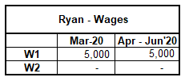
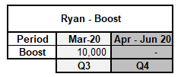
Boosting Cashflow - EMPLOYERS ONLY
Example Continued
His boost will look like this;
Quarterly
Ryan runs a trendy cafe in Wagga, he has 2 casual employees who earn around $10,000 per year each
His BAS look like this: I THINK HIS BOOST WILL ALSO HAVE 5,000 IN JUNE AND 5,000 IN SEPTEMBER.
:

Slide 11
Support for Business
Business Investment (BBI)
Business with an aggregated annual turnover of less than $500 million can depreciate assets at an accelerated rate (50% plus normal depreciation on the reduced balance)
Essentially for items over $150k. OR OTHER EMPLOYERS IN 2021 FOR ITEMS OVER 1000.
Eligibility
Is not second hand, a building or capital works
Is an asset for which the entity has not claimed depreciation deductions (including under the instant asset write off rules)
Acquired and first used or installed ready for use for a taxable purpose between 12th March & 30th June 2021.
Link - https://www.ato.gov.au/Business/Depreciation-and-capital-expenses-and-allowances/Backing-business-investment---accelerated-depreciation/

Slide 12
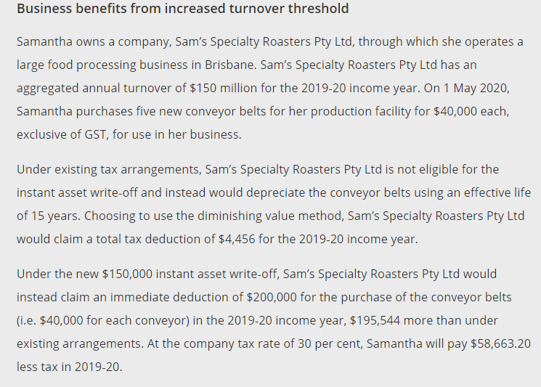
Example of Increased Threshold on future tax
(existing cap - $50 million).

Slide 13
Support for Business
Instant Write off - Example
A company purchases a TRACTOR for $66,000 inc. GST, delivered before 30/06/2020.
The benefit of the stimulus would be:
A tax deduction of $60,000
NOTE 1: THIS IS A TAX DEDUCTION - NOT A REFUND
NOTE 2: WHEN YOU DISPOSE OF THIS ASSET (TRADE IT IN) THE TRADE IN WILL BE TAXABLE INCOME - IT IS NOT OFFSET AGAINST THE POOL.

Slide 14
Assistance for apprentices/trainee’s
Snapshot
Can apply for a wage subsidy of 50% of the wage paid to the apprentice
Max - $21k per apprentice ($7,000 /quarter)
Apprentice must be employed prior to 1 March 2020
Covers the period 1st January to 30th September 2020
Apprentice changing jobs can carry entitlements with them to the new employer
Eligibility
Small business employing less than 20 full time employee’s
Eligibility assessment is undertaken by Australian Apprenticeship Support Network
Apply from early April 2020, Final claim in 31st December 2020
More information - https://www.australianapprenticeships.gov.au/
Can’t do this and the Jobkeeper at same time

Slide 15
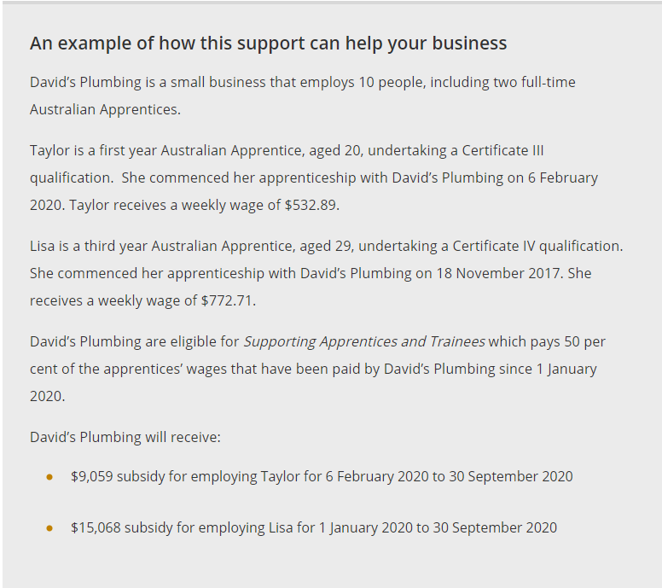

Slide 16
Guarantee of lending to businesses
Supporting the flow of Credit
Grant guarantees to banks. Loans made or to be made to businesses to assist in dealing with the impacts of COVID-19. (rent & staff expenses)
Business with up to $50m turnover
Guarantee of 50%
Maximum loan amount $250,000 per borrower
Loan term – 3 years, with 6 month repayment holiday
Security – unsecured (no assets will need to be provided as security)
Subject to lenders credit assessment (long term view, not current view)
Starting early April 2020, end 30th September 2020 (participating lenders only)
Exemption from responsible lending obligations for lenders (6 months, predominantly for business use)
RBA is providing $90 billion in funding at 0.25% (to banks)
https://treasury.gov.au/coronavirus/sme-guarantee-scheme

Slide 17
Guarantee of lending to businesses
Government Support
APRA – Relaxing Capital reform & Adjusts the banks capital ratio’s/expectations
Australian Office of Financial Management (AOFM) – investing in market securitisation market
RBA – Printed $30bn of cash this week

Slide 18
Relief for Financially distressed businesses
Temporary higher thresholds & more time to respond to demands from creditors
Minimum Debt to initiate involuntary bankruptcy increased from $5k to $20k & Time frame increased from 21 days to 6 months
Minimum Amount for a creditor to issue a statutory demand has increased from $2k to $20k & response time has increased from 21 days to 6 months
Directors will be protected for insolvent trading – Temporary only

Slide 19
Support for Individuals
Expanded access to Centrelink
Self Employed, casuals, contract workers
Reduced means testing & Liquid asset test waived - (has just been increased from $48k to $80k)
Reduced waiting times
Monies are taxable
COVID-19 Supplement of $550/fortnight on top of the current jobseeker payments (will be $1,070/fortnight from end of April)
Starts 27th April 2020.
What to do
Currently getting an allowance from Government
Don’t need to do anything
Will last for 6 months
NOT Currently getting an allowance from Government
Claim online through myGov (Centrelink account) or phone – 132 850

Slide 20
Support for Individuals
Economic support payments to households
1st payment of $750 from 31st March to the 17th April
2nd payment of $750 on 13th July 2020
Eligibility
Pension
Allowance (Newstart, Youth, Austudy, Family Tax Benefit A&B)
Concession Card
Health Care Card

Slide 21
Support for Individuals
Superannuation – Early Access
Individuals can withdraw up to $10k from super in the 2019 & 2020 financial year on compassionate grounds. (each person is allowed up to 2 releases)
Amounts released not subject to tax
Apply through myGov website
1st Instalment – apply before 1st July 2020
2nd Instalment - apply from 1st July to the 24th September 2020
Eligibility
Unemployed
Eligible for jobseeker payment, parenting allowance, youth allowance, farm household allowance
From 1st January 2020,
You were made redundant
Working hours reduced by at least 20%
If Sole trader, your business was suspended or there was a reduction in your turnover of 20% or more.

Slide 22
YOU, THE NEW CENTRELINK
Job Keeper payment
Provides $1,500/fortnight per employee for 6 months (can be topped up by employer)
Employees can keep their job (can be at reduced hours)
Also available to self employed
Will allow businesses to reactivate their operations quickly without having to rehire when the crisis is all over
Eligible Employers
Business has a turnover of less than $1 billion.
Turnover has been reduced by 30% to 50% compared to previous period (year, etc)
Must have employees as at 1st March 2020
All business types, including not-for-profits, charities, self employed individuals (no employees)
Eligible Employees
Currently employed (includes those stood down or rehired)
Employed as of the 1st March 2020
Full time, part time, long term casuals (longer than 12 months)
Australian citizen, permanent visa, residing in Australia longer than 10 years
Can’t double dip with jobseeker allowance

Slide 23
JOBKEEPER
How to Apply
Via the ATO (will administer going forward)
Register your interest from 30th March - https://www.ato.gov.au/general/gen/JobKeeper-payment/
Employers - Online application & provide monthly updates to the ATO
Employer to process payments as per current process
Self employed – ABN, TFN & monthly updates to the ATO
Payments will be made directly to the individuals bank account

Slide 24
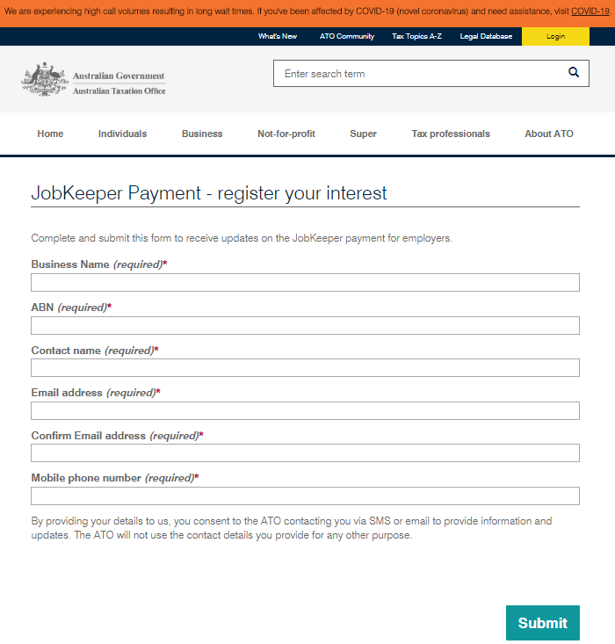
JOBKEEPER

Slide 25
Pathway 1 - based on employees
Temporary cashflow support for Employers
30% Decline in Turnover
In business at March 1
Must have an ABN as 12 March - INTEGRITY RULES
Assessable income 18/19 year provable - INTEGRITY RULES eg BAS or tax return
Exceptions for start up
Active business making taxable supplies - INVESTORS DO NOT COMPLY
Payments start to flow from 1 May
Notify ATO re employees
No double dip (another employer or Jobseeker Allowance) - MUST HAVE CONSENT OF EMPLOYEE
Eligible Employees
employed as at 1 March, if stood down can be rehired
aged 16+
permanent or part-time
if casual must be long term - minimum 12 months (regular basis)
exclusions - paid parental leave (may be others I am not sure of)
Harsh Tax penalties for Taxpayers who manipulate their affairs

Slide 26
Pathway 2 - self-employed
ENTITY TYPE ELIGIBLE PERSON
SOLE TRADER OWNER/SOLETRADER
PARTNERSHIP ONE PARTNER ONLY
TRUST ONE BENEFICIARY
COMPANY ONE DIRECTOR OR SHAREHOLDER
As you can see restricted to ONE person ONLY
Applies to non employed working owners
The business must nominate
Harsh Tax penalties for Taxpayers who manipulate their affairs

Slide 27
Jobkeeper to 27 September 2020
Payment process
Government aware shortage of funds so grace given for late payments to employees in April - no latitude after this date if employees paid late
Must register with the ATO by 26 April to start receiving money in early May
ATO must pay within 14 days of the end of the calendar month
The ATO cannot withhold payment and offset to your other tax debts
Single Touch Payroll (STP) employers most likely paid very quickly
Superannuation a little unclear
receiving $1500 f/n but no work then NO super
working and earning more than $1500f/n then YES super as normal
Unclear if working say 600 per f/n - I believe super on the 600 but nothing else
Others believe NO SUPER obligation

Slide 28
Q & A Session

Slide 29
How Can We Help

Slide 30
Disclaimer
Important note: While every care has been taken in the preparation of this presentation, we makes no representation or warranty as to the accuracy or completeness of any statement in it, without limitation. This document has been prepared for the purpose of providing general information, without taking account of any particular individual’s objectives, financial situation or needs. Before making any investment decisions, please consider the appropriateness of the information in this presentation, and seek professional advice, having regard to the individual objectives, financial situation and needs.

